Slide 1


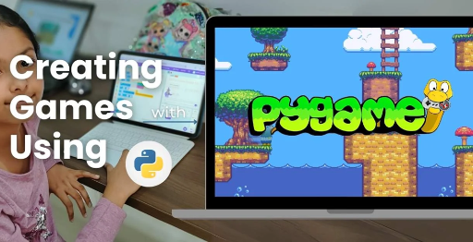
Session 11
Asset Management & Audio Integration

Slide 2
Learning Objectives
Understand game inspiration, install Pygame-CE, navigate project structure
Detailed Objectives:
Objectives:
Organize and preload game assets (images, fonts) using assets.py.
Add background images and sound effects (if Pyodide-compatible).
Enhance the game’s visual and audio appeal.

Slide 3
Practical Tasks
Understand game inspiration, install Pygame-CE, navigate project structure
Below is the list of Practical Tasks:
Update assets.py to preload all assets (birds, blocks, backgrounds, power-up icons, fonts).
Add a background image to the gameplay screen.
(Optional) Add Pyodide-compatible sound effects using NumPy arrays with pygame.sndarray.make_sound() for bird launches or collisions.
Test asset loading and rendering for performance.

Slide 4
Deliverables
Understand game inspiration, install Pygame-CE, navigate project structure
Session Deliverables:
assets.py with organized asset loading.
A gameplay screen with a background image and (optional) sound effects.
Tips:
Use free assets from sources like Freepik or 1001fonts.com.
Test sounds with headphones to avoid disturbing others.

Slide 5
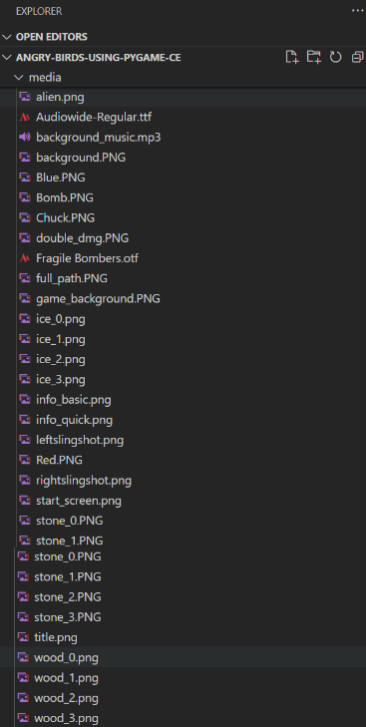
Asset Management & Audio Integration in PyGame
🎨 Asset Management & Audio Integration in PyGame
CODE SNIPPETS :

Slide 6
Design What You Hear and See
🎨 "Design What You Hear and See"
👉 “Managing images, icons, and sounds to bring your game to life” 👉 Introduce the role of assets in a game’s polish, performance, and player engagement.
“Managing images, icons, and sounds to bring your game to life”
Introduce asset management in OMOTEC-PyGame: Siege of Avaria!
Inspired by Angry Birds, enhances two-player fortress battles.
Focus: Use visuals and sounds for polish and engagement.
Learn to manage assets with Pygame-CE for immersive gameplay.
Covers assets for birds, blocks, and UI elements.

Slide 7
What Are Game Assets?
🎨 What Are Game Assets?
🖼️ Visuals: Birds, blocks, backgrounds, power-ups
🔊 Audio: Bird launch, crash sounds (optional with Pyodide)
🔤 Fonts: Game score, game over screens
📦 Stored in the media/ folder 📌 Loaded centrally using assets.py
Visuals: Birds (red.png), blocks (wood.png), backgrounds, power-up icons.
Audio: Bird launch or crash sounds (optional with Pyodide).
Fonts: Text for scores, game-over screens (e.g., sci-fi.ttf).
Stored in media/ folder for organized access.
Loaded centrally via assets.py for efficiency.
Critical for setting game tone and player immersion.

Slide 8
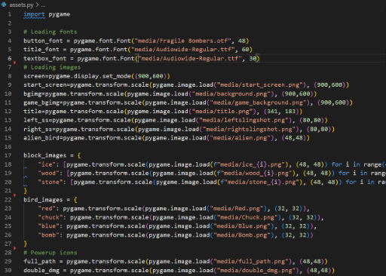
What Are Game Assets?
🎨 Asset Management & Audio Integration in PyGame
📌 Loaded centrally using assets.py CODE SNIPPET :

Slide 9
Why Use assets?
🎨 Why Use assets.py?
Keeps game files clean and modular
Reduces memory loading errors
Makes it easier to manage updates
🧠 Think of assets.py as your game's media library manager
Keeps game code modular and organized.
Reduces memory errors by loading assets once.
Simplifies updates to visuals or sounds.
Acts as a media library manager for the game.
Integrates with main.py and game_modes.py for rendering.
Ensures consistent asset use across Quick and Basic modes.

Slide 10
Organize Your Media Folder
🎨 Organize Your Media Folder
📂 media/
birds/: red.png, blue.png
blocks/: stone.png, wood.png
backgrounds/: battlefield.png
fonts/: sci-fi.ttf
icons/: powerup_damage.png
📌 Use naming conventions for clarity
Organize Your Media Folder
media/ structure:
birds/: red.png, blue.png
blocks/: stone.png, wood.png
backgrounds/: battlefield.png
fonts/: sci-fi.ttf
icons/: powerup_damage.png
Use clear naming conventions (e.g., type_name.png).
Supports easy access in assets.py for loading.
Keeps assets organized for scalable game design.

Slide 11
Load Assets in assets.py
🎨 Load Assets in assets.py
self.bird_images
self.font = pygame.font.Font("media/fonts/sci-fi.ttf", 36)
💡 Load all files once, use them everywhere
Load Assets in assets.py
In assets.py:
self.bird_images = {
"red": pygame.image.load("media/birds/red.png"),
"blue": pygame.image.load("media/birds/blue.png")
}
self.font = pygame.font.Font("media/fonts/sci-fi.ttf", 36)
Load all assets once for efficient memory use.
Supports rendering in main.py or game_modes.py.
Enables dynamic visuals for birds, blocks, and UI.
Uses media/ folder for centralized storage.

Slide 12
Add Backgrounds to the Game
🎨 Add Backgrounds to the Game
In main.py or game_modes.py:
background = assets.background_images["battlefield"]
screen.blit(background, (0, 0))
🎯 The right background sets the theme and tone for players
In main.py or game_modes.py:
background = assets.background_images["battlefield"]
screen.blit(background, (0, 0))
Sets game theme (e.g., battlefield, space) for immersion.
Loaded via assets.py from media/backgrounds/.
Rendered each frame in game loop for consistency.
Enhances visual appeal in both game modes.
Tested for smooth integration with gameplay.

Slide 13
Integrate Audio
🎨 Integrate Audio
If using Pyodide-compatible audio:
import pygame.sndarray
import numpy as np
sound = pygame.sndarray.make_sound(np.array([...]))
sound.play()
🎧 Sound on bird launch or collision adds impact feedback
For Pyodide-compatible audio in assets.py:
import pygame.sndarray
import numpy as np
sound = pygame.sndarray.make_sound(np.array([...]))
sound.play()
Adds impact feedback for bird launches or collisions.
Uses 2D NumPy arrays for stereo sound compatibility.
Stored in media/ (e.g., crash.mp3).
Enhances immersion if supported by environment.

Slide 14
Test for Load Performance
🎨 Test for Load Performance
Use print("Loaded background") to verify asset access
Check framerate: large assets can slow gameplay
Test on different machines
🧪 Tip: Use compressed PNGs and MP3s for better speed
Verify asset loading: print("Loaded background") in assets.py.
Check framerate to ensure large assets don’t slow gameplay.
Test on different machines for consistent performance.
Use compressed PNGs and MP3s for faster loading.
Monitor main.py game loop for rendering issues.
Debug with tools.py for visual rendering errors.

Slide 15
Student Exercise Task – Build a Themed Asset Set
🎨 Student Exercise Task – Build a Themed Asset Set
🎯 Your Challenge:
Create your own visual theme (e.g., space, jungle)
Replace:
Background
Bird icons
Block textures
Load them in assets.py
📂 Deliver: updated media/ folder + preview screenshot
Challenge:
Create a visual theme (e.g., space, jungle).
Replace background, bird icons, and block textures.
Update assets.py to load new assets.
Capture screenshot of themed gameplay.
Deliverables: Updated media/ folder, assets.py, screenshot.
Save as: my_themed_assets.py.
Submit for feedback on theme and functionality.

Slide 16
Session Recap – Build a Sensory Game World
🎨 Session Recap – Build a Sensory Game World
👉 You now understand how to:
Organize and load assets
Add backgrounds and fonts
Experiment with simple sound logic 💬 Tip: Visual + audio feedback = more immersive gameplay
Achievements:
Organized and loaded assets in assets.py.
Added backgrounds and fonts for visual polish.
Experimented with optional audio logic.
Created immersive gameplay with themed assets.
Design tip: Prioritize compressed assets for performance.
Reference: Pygame CE Documentation (https://pyga.me/docs/).

Slide 17
Session Recap – Build a Sensory Game World
🎨 Asset Management & Audio Integration in PyGame
📌 Loaded centrally using assets.py CODE SNIPPETS :

Slide 18

Exercise:
1. What is the primary objective of the Quick Mode in OMOGAME?
A) Collect all power-ups before the opponent
B) Launch birds without any destruction
C) Reach a score of 200 points
D) Complete the entire storyline
Answer: C) Reach a score of 200 points
2. Which file is considered the main entry point of the OMOGAME project? A) tools.py
B) main.py
C) assets.py
D) classes.py
Answer: B) main.py

Slide 19
Exercise..
3. What does the tools.py file mainly handle in the game?
A) Launching sound and animation
B) Player avatar selection
C) Collision detection and drawing functions
D) Managing game instructions
Answer: C) Collision detection and drawing functions
4. Which of the following is NOT listed as a unique feature of OMOGAME? A) Bird classes with special physics
B) Alien targets for bonus points
C) Multiplayer online matchmaking
D) Destructible block environments
Answer: C) Multiplayer online matchmaking

Slide 20
Exercise…
5. Why is organizing the OMOGAME project into files like classes.py, media/, and game_modes.py important?
A) It reduces the game’s memory usage
B) It helps reduce the number of bugs completely
C) It makes the project look colorful
D) It simplifies managing and updating different game parts
Answer: D) It simplifies managing and updating different game parts

Slide 21
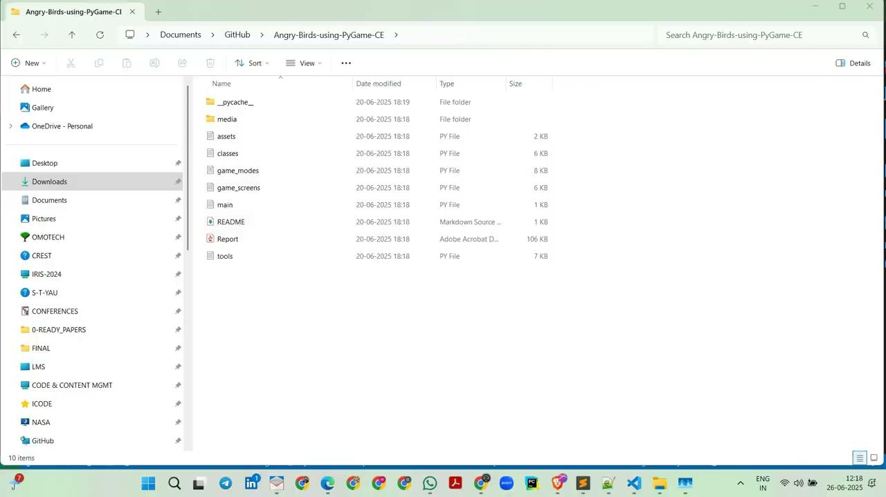
Session 11 VIDEO LINK
Asset Management & Audio Integration

